Slide 1
Game AI – Part III
Introduction to Game Design and Development
ITCS 4230/5230
Dr. Dewan Tanvir Ahmed
Department of Computer Science
University of North Carolina at Charlotte

Slide 2
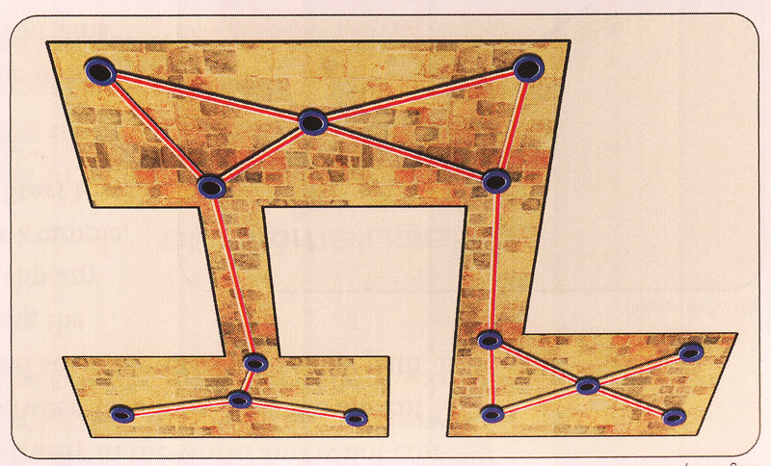
Path Finding
Path Planning
Path Searching
BFS and DFS
Table Lookup
Dijkstra Algorithm
Best First Search
A* Search
Path Exploration

Slide 3
Introduction
Almost every game requires pathfinding
Agents must be able to find their way around the game world
Pathfinding is not a trivial problem
Fastest and most efficient pathfinding techniques consume a lot of resources

Slide 4
Path Planning
Path planning is the process of determining a destination for an agent
Requirements:
Minimum movement
Only one agent at a node
Rules:
Choose the closest available node
Mark nodes as occupied or destination

Slide 5
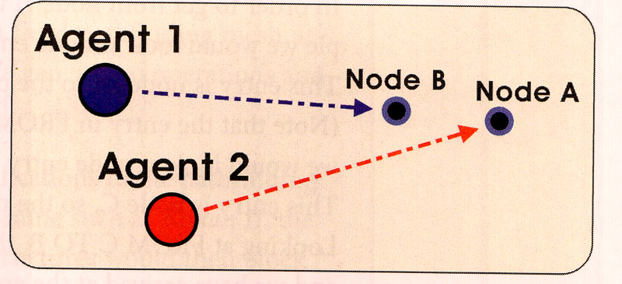
Examples
Both agents are able to follow a direct path to their respective goals

Slide 6
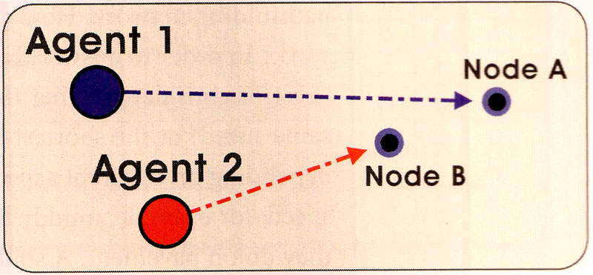
Examples
Agent 2 selects an alternate destination, node B, to avoid stacking on agent 1

Slide 7
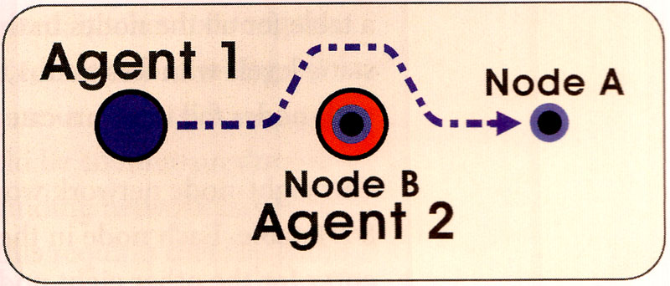
Examples
Agent 2 stops at node B, forcing agent 1 to turn four times to reach node A

Slide 8
Path Planning Algorithms
Must search the space to move an NPC to goal state
Computational Issues:
Completeness
Will it find an answer if one exists?
Time complexity
Space complexity
Optimality
Will it find the best solution

Slide 9
Searching for a Path
A path is a list of cells, points, or nodes an agent must traverse
Consists of a set of path nodes –
each one corresponding to a point in the game world
Each node is linked to its adjacent nodes
A pathfinding algorithm finds a path
From a start position to a goal position

Slide 10
Representing the Search Space
Pathfinding algorithms can be used on
Grids
Waypoint graphs
Navigation meshes
One scheme more appropriate than the others and based on
The genre of a game
The type of levels
The number of agents, and many other constraints

Slide 11
Grids
Regular grids (equally spaced nodes)
Rectangular or hexagonal
Easy to generate automatically
Arbitrary grids
Require hand-selected nodes
Provide better node position and less data

Slide 12
Grids (cont.)
2D grids – intuitive world representation
RTS games such as Age of Empires and Warcraft III
Works well for many games including some 3D games such as Warcraft III
Each cell is flagged
Passable or impassable
Each object in the world can occupy one or more cells

Slide 13
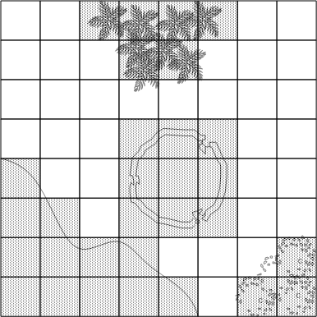
Grid Characteristics/Advnatages
Fast look-up
Easy access to neighboring cells
Complete representation of the level

Slide 14
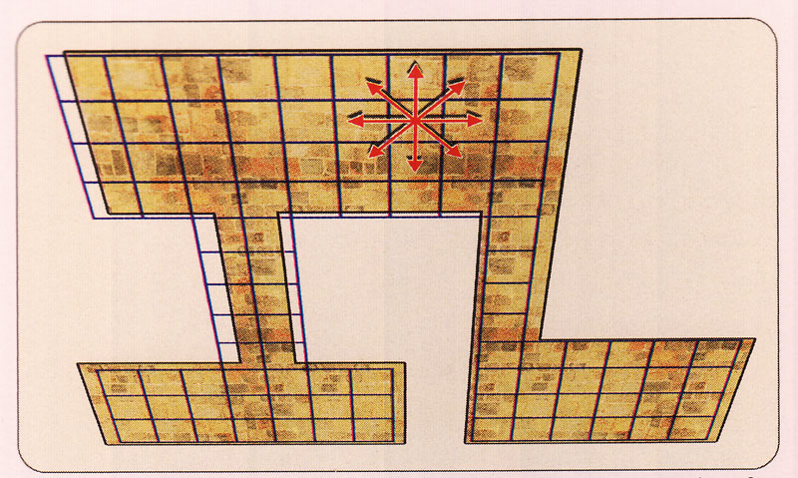
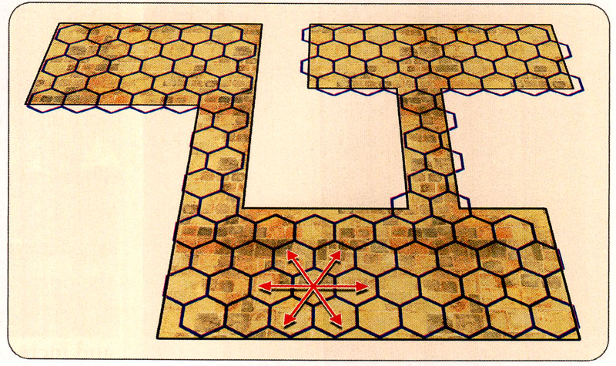
Regular Grids
A two dimensional array maps to the rectangular mesh
Easy to calculate position
Complicated to deal with
Adjacent nodes are equidistance from the center node
Visually pleasing

Slide 15
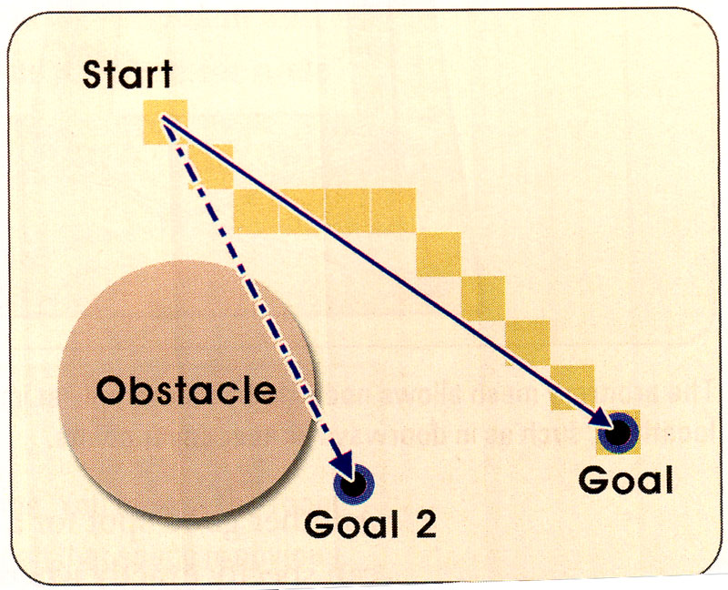
Regular Grids
Path on a rectangular grid tends to have a stair-step appearance
Make sure agent does not clip any obstacles

Slide 16
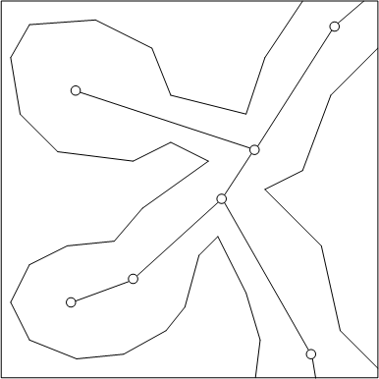
Waypoint Graph
Instead of specifying passable and impassable parts of the level - a waypoint graph specifies lines/routes that are “safe” for traversing.
An agent can choose to walk along any of these lines without having to worry about running into major obstacles or falling into ditches or off a ramp.
Each line (or link) connects exactly two waypoints

Slide 17
Waypoint Graph Characteristics
Waypoint node can be connected to any number of other waypoint nodes
Waypoint graph can easily represent arbitrary 3D levels
Can incorporate auxiliary information
Such as ladders and jump pads
Incomplete representation of the level
Example:
Many FPS games such as Unreal Tournament and Half-Life use waypoint graphs.

Slide 18
Arbitrary Grids
Nodes can be placed exactly where a path following movement is desired
Example: center of doorway
Less data than a regularly spaced grid

Slide 19
Navigation Meshes
Combination of grids and waypoint graphs
Every node of a navigation mesh represents a convex polygon (or area)
As opposed to a single position in a waypoint node
Advantage of convex polygon
Any two points inside can be connected without crossing edge of polygon
Navigation mesh can be thought of as a walkable surface

Slide 20
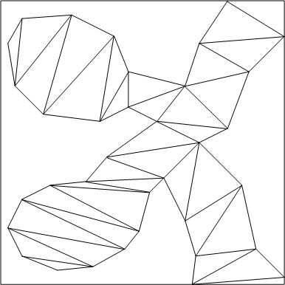
Navigation Meshes (con’t)

Slide 21
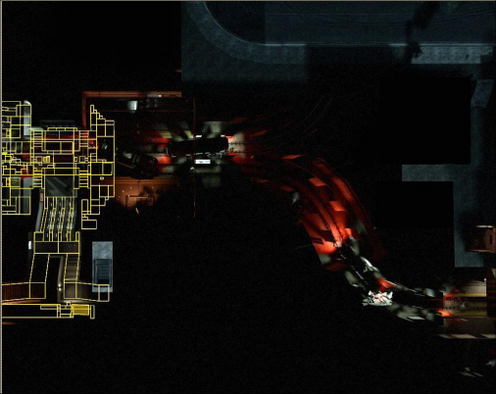
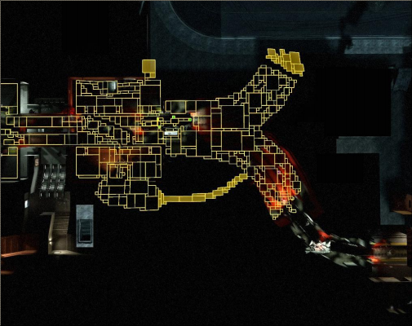
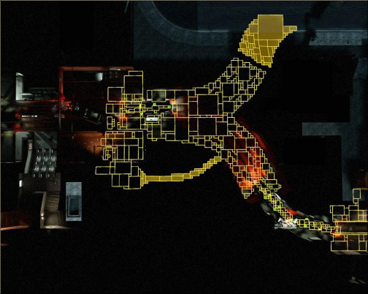
Left 4 Dead (L4D) Active Navigation Mesh

Slide 22
Navigation Mesh Characteristics
Complete representation of the level
Combines pathfinding and collision detection together
Can easily be used for 2D and 3D games

Slide 23
Search Strategies
Blind search
No domain knowledge.
Only goal state is known
Heuristic search
Domain knowledge represented by heuristic rules
Heuristics drive low-level decisions
Apply approximate knowledge
Distance measurements to goal
Cost estimates to goal
Use the estimate to steer exploration

Slide 24
Path Searching
Agent on one node needs to go to another. What’s the best path?
Shortest distance (constant speed)
Shortest time (variable speed)
Table look-up
Search algorithms
Breadth first search
Dijkstra’s algorithm
Best first search
A* search

Slide 25
Random Trace
Assume that the map only contains relatively small convex obstacles
Simple algorithm
Agent moves towards goal
If goal reached, then done
If obstacle
Trace around obstacle clockwise or counter-clockwise (pick randomly) until free path towards goal
Repeat procedure until goal reached

Slide 26
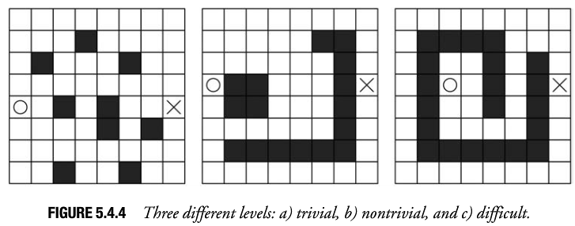
Random Trace (continued)
How will Random Trace do on the following maps?
It would be much better for the agent to trace clockwise when he runs into the obstacles in Figure 5.4.4b, rather than trace counter clockwise.
The Random-Trace algorithm does not even guarantee to find a path from start to goal in a finite amount of time for the map in Figure 5.4.4c.

Slide 27
Random Trace Characteristics
Not a complete algorithm
Found paths are unlikely to be optimal
Consumes very little memory

Slide 28
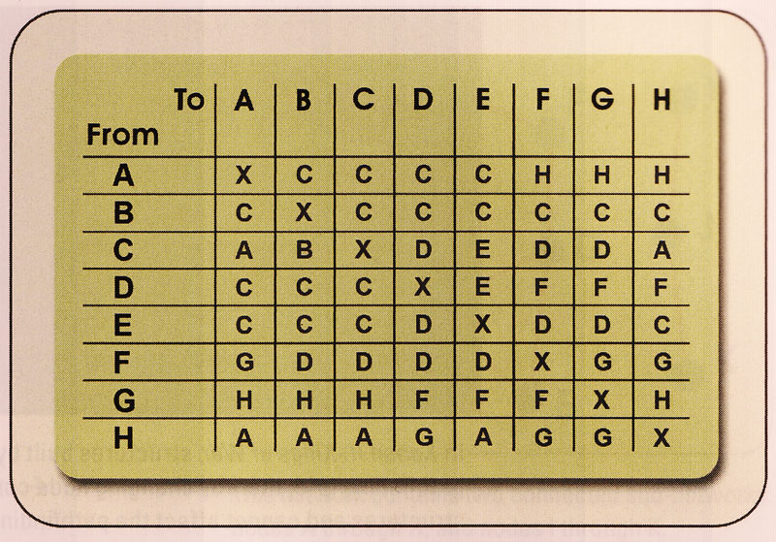
Table Lookup
Most efficient way (less than 1000 nodes)
Example
Node H to Node B: H -> A -> C -> B

Slide 29
Table Lookup - Pros and Cons
Potentially faster than doing a search through the network
Storage size
250 nodes – 64K
2000 nodes – 8MB
Large RTS map 80,000 nodes – several gigabytes
Alternative:
We can use hierarchical tables but still large data is needed

Slide 30
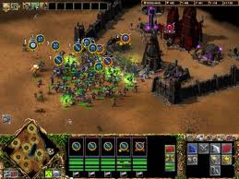
Table Lookup - Pros and Cons
Must be pre-compiled
Static geometry
Halflife-2 and Halo-2
Multiple tables
Kohan II
Mixed with search algorithms for efficiency and to deal with temporary changes in pathfinding network

Slide 31
Search Algorithms
Guidelines:
If a path exist, algorithm must find it.
If multiple paths exit, the algorithm must find the best path.
If no path exists, the algorithm must terminate (not search forever)
The algorithm must be efficient.

Slide 32
Breadth First Search (BFS)
A good starting point
Based on exploring all “un-visited” neighbours for each node
Uses a queue structure
First-in first-out
Add A: A
Add B: AB
Add C: ABC
Remove A: BC
Add D: BCD

Slide 33
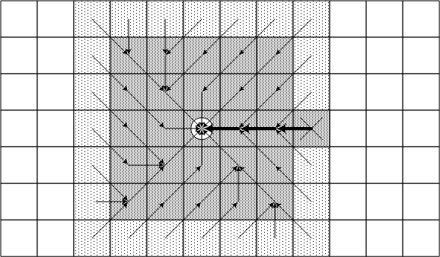
Breadth First Search (BFS) – cont.
Finds a path from the start to the goal by examining the search space ply-by-ply

Slide 34
BFS Algorithm
for each node v in Graph
visited[v] = false ; previous[v]=NULL
visited[source] = true
add source to Q
while Q not empty
remove one node u from queue
for all neighbours v of the node u
if visited[v] != true
if v==target TERMINATE
visited[v] = true
previous[v] = u
add v to Q

Slide 35
Breadth-First Characteristics
Exhaustive search
Systematic, but not clever
Consumes substantial amount of CPU and memory
Guarantees to find paths that have fewest number of nodes in them
Not necessarily the shortest distance!
Complete algorithm

Slide 36
Depth First Search
Push root node
Pop node & examine
If stack is empty, all nodes have been examined – quit search & return "not found"
Repeat from Step 2

Slide 37
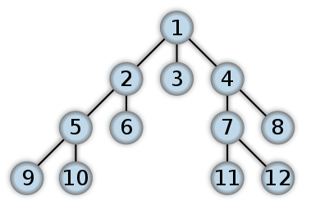
Depth-First Search (DFS)
Search for Goal down to some depth (the search "horizon").
Notes:
How appropriate are these search approaches?

Slide 38
Dijkstra’s Algorithm
It solves the single-source shortest path problem for a graph with non-negative edge path costs, producing a shortest path tree.
Dijkstra’s algorithm uses priority queues to allow selecting nodes that are closer (or have a lower “cost” in general)
Links between nodes need to have a cost (distance) value.

Slide 39
Dijkstra’s Algorithm
dist[s] ←0 (distance to source vertex is zero) for all v ∈ V–{s} do dist[v] ←∞ (set all other distances to infinity) S←∅ (S, the set of visited vertices is initially empty) Q←V (Q, the queue initially contains all vertices) while Q ≠∅ (while the queue is not empty) do u ← mindistance(Q,dist) (select the element of Q with the min. distance) S←S∪{u} (add u to list of visited vertices) for all v ∈ neighbors[u] do if dist[v] > dist[u] + w(u, v) (if new shortest path found) then d[v] ←d[u] + w(u, v) (set new value of shortest path)
(if desired, add traceback code)
return dist

Slide 40
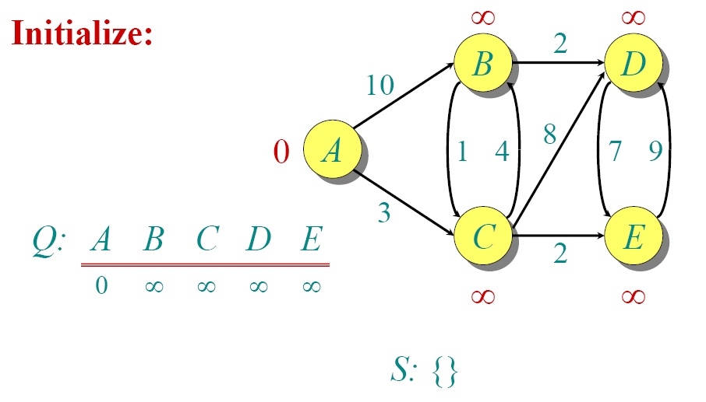
Dijkstra Example

Slide 41
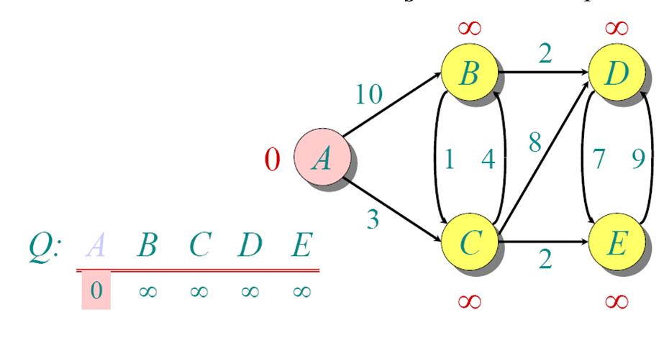
Dijkstra Example

Slide 42
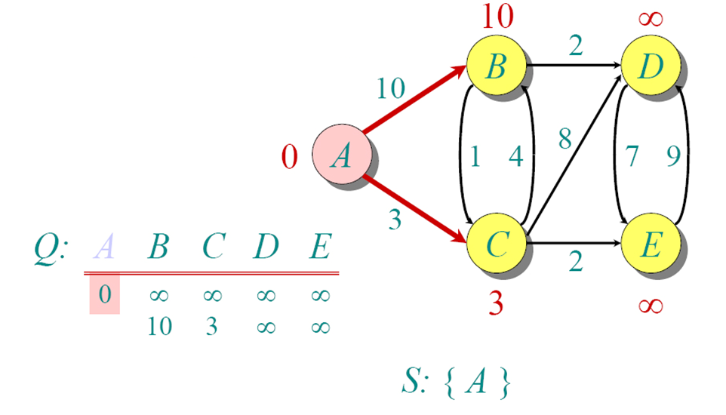
Dijkstra Example

Slide 43
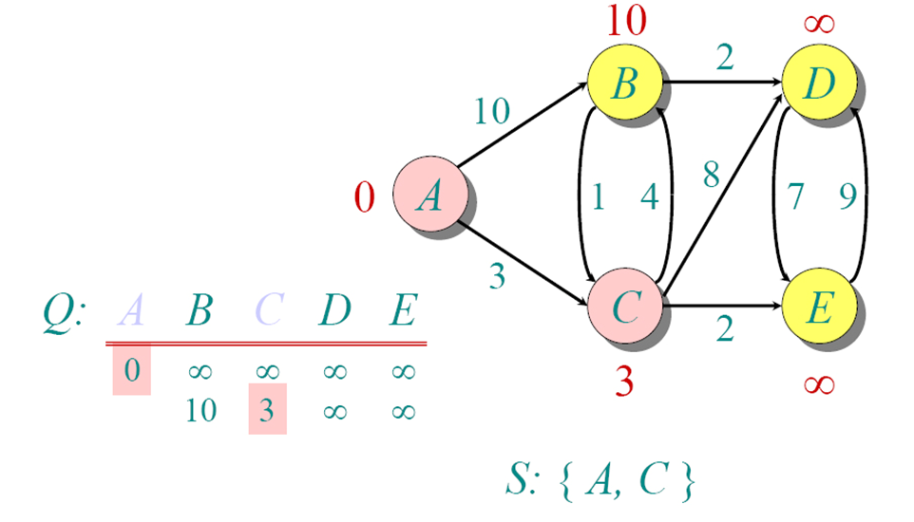
Dijkstra Example

Slide 44
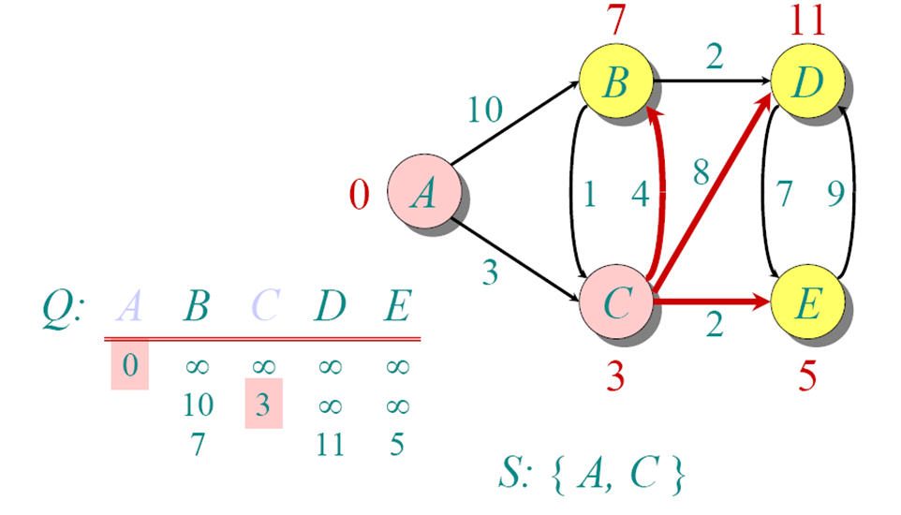
Dijkstra Example

Slide 45
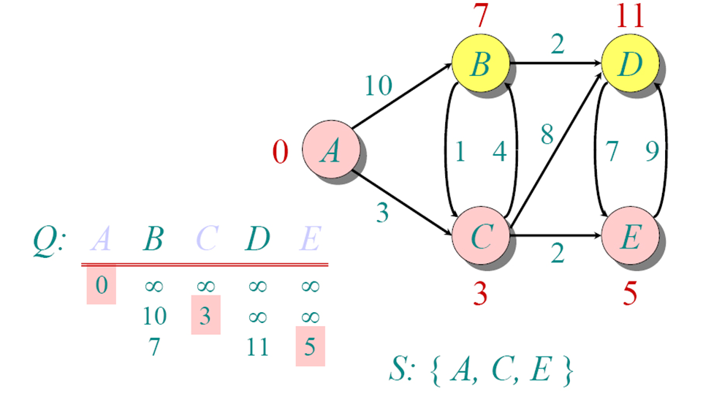
Dijkstra Example

Slide 46
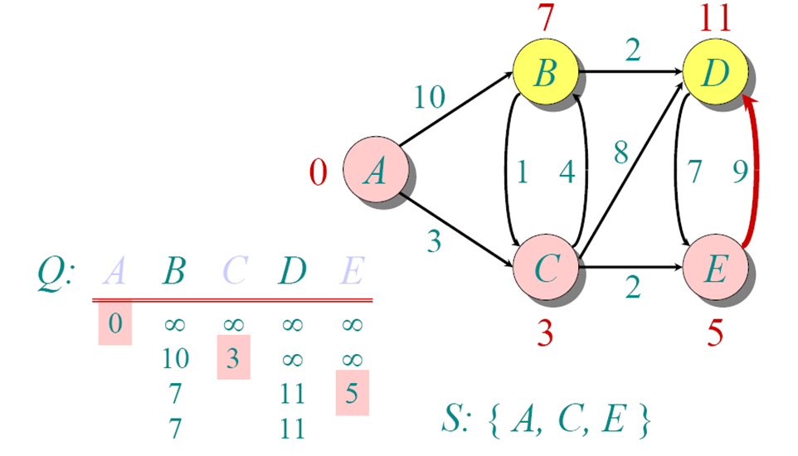
Dijkstra Example

Slide 47
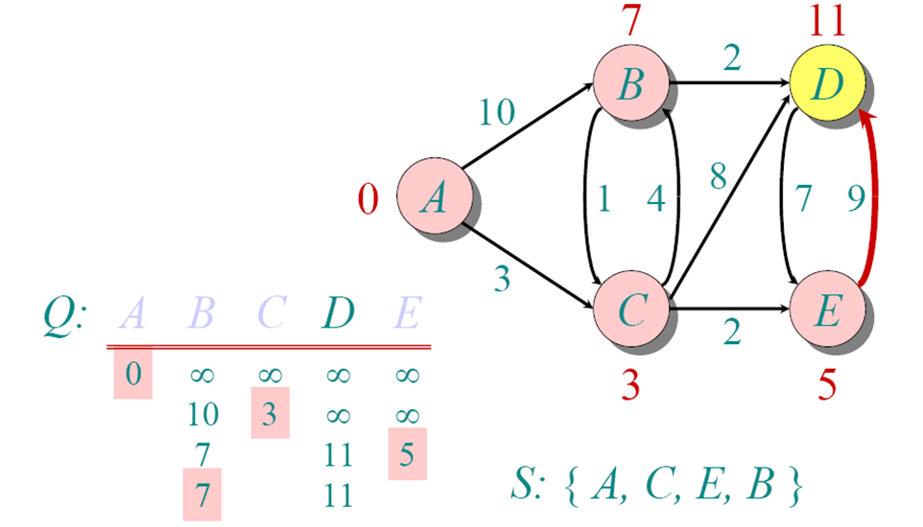
Dijkstra Example

Slide 48
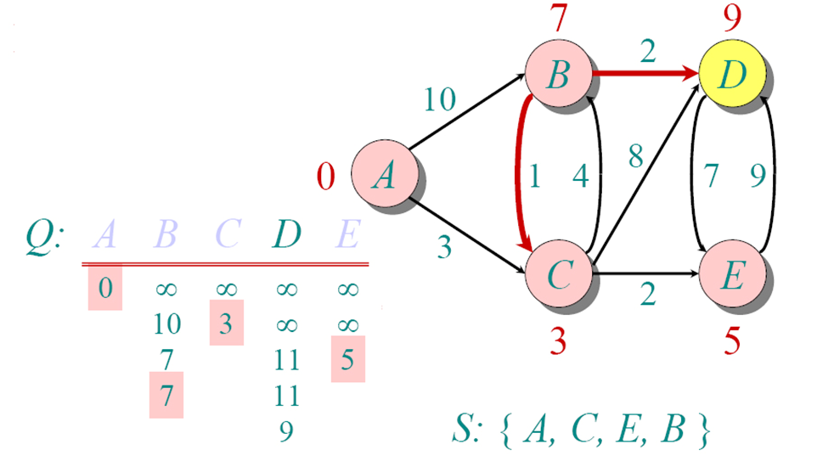
Dijkstra Example

Slide 49
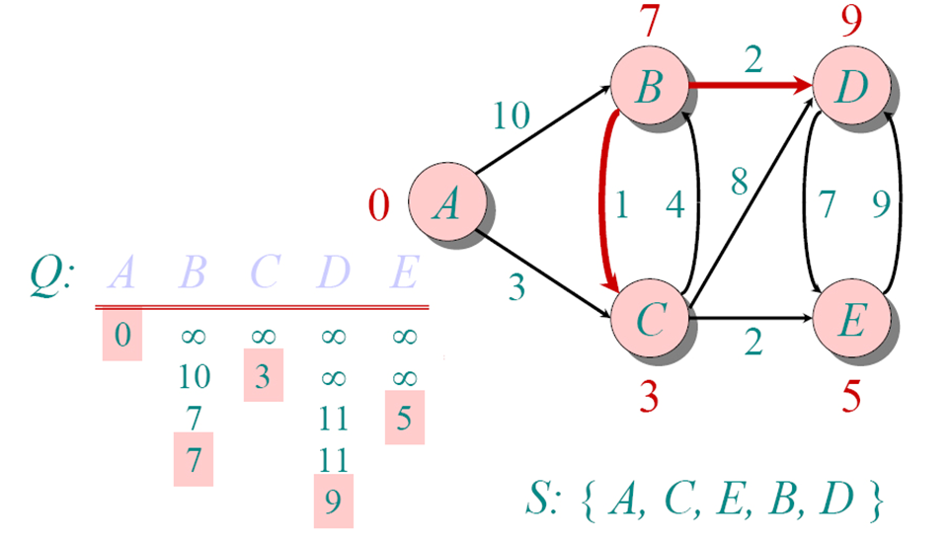
Dijkstra Example

Slide 50
Evaluation
Meets the criteria 1 to 3.
Examples of application
When teleportation is possible. Distance zero is acceptable in algorithm
Not very efficient
Examines all neighbours even if far from target.
More Example: Youtube

Slide 51
Best-First Search
Best-First is a heuristic search.
Best-first search is a search algorithm which explores a graph by expanding the most promising node chosen according to a specified rule.
Uses problem specific knowledge to speed up search
Computes distance of every node to goal

Slide 52

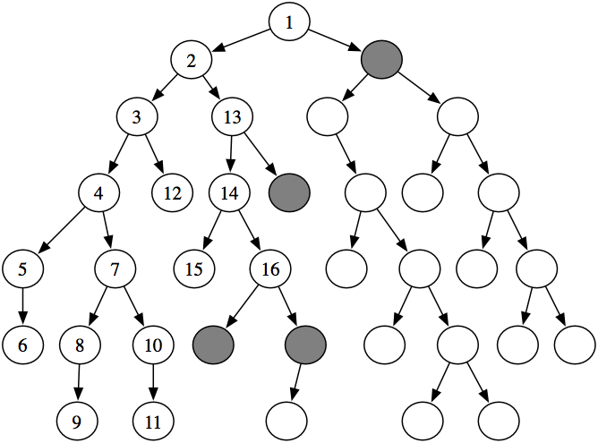
Best-First Search – Cont.
How to search? Generic search algorithm
Given a graph, a start and goal nodes, and incrementally explore paths from the start nodes to reach the goal.
Frontiers
Notes:
Start at the start state
Evaluate where actions can lead us from states that have been encountered in the search so far
Stop when a goal state is encountered

Slide 53
Best-First Search – Cont.
Uniform Cost Search
Search with evaluation function g(n)
g(n) = work done so far
optimal and complete but can be very slow.
g(n)
n
s
d
5
2
5
2
5
2
1
7
1
7
Intuition: Expand the cheapest node. Where the cost is the path cost g(n)
4
5

Slide 54
Best-First Search – Cont.
Greedy BestFirst Search
Estimates how far away the goal is [evaluation function h(n)].
Neither optimal nor complete.
Can be very fast.
h(n)
n
s
d
17
19
17
19
17
19
16
14
16
14
13
15
Intuition: Expand the node you think is nearest to goal. Where the estimate of distance to goal is h(n)

Slide 55
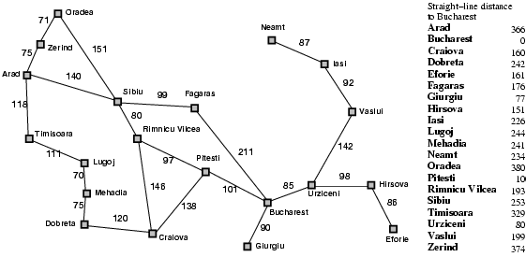
Best-first search example
Expand the node that has the lowest value of the heuristic function h(n)

Slide 56

Best-first search example

Slide 57
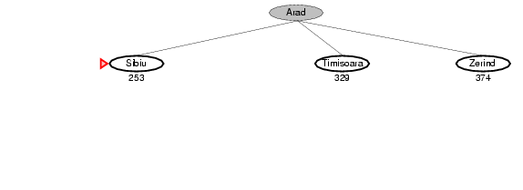
Best-first search example

Slide 58
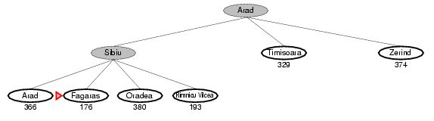
Best-first search example

Slide 59
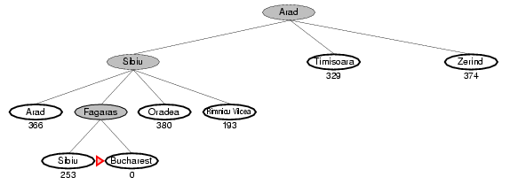
Best-first search example

Slide 60
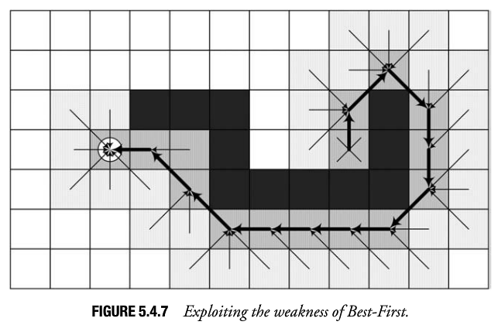
Best-first search example

Slide 61
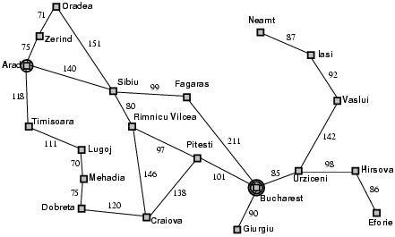
Properties of greedy best-first search
On average, Best-First is much faster than Breadth-First and uses significantly less memory. It typically creates very few nodes and tends to find “good quality” paths.
Is it Complete? -- Can stuck and loop
start
goal

Slide 62
Properties of Best-first search
Is it Optimal?
No

Slide 63
A* Search
Best First Search uses the estimated distance to target instead of distance from source.
“Straight line” heuristic.
Can return a zig-zag path if there are obstacles.
A* is a combination of Dijkstra and Best First

Slide 64
A* Search
Idea: avoid expanding paths that are already expensive Evaluation function f(n) = g(n) + h(n)
g(n) = cost so far to reach n
h(n) = estimated cost from n to goal
f(n) = estimated total cost of path through n to goal
g(n)
n
h(n)

Slide 65
A* Search Algorithm
dist[source] = 0
ETT[source] = Estimate(source,target)
Add source to Q
While Q not empty
remove u (node in Q with smallest DFS) from Q
Add u to ClosedList
if u==target, TERMINATE
for each neighbor v of u
if v not in OpenList AND v not in OpenList
dist[v] = dist[u] + dist_between(u, v)
ETT[v] = Estimate(v,goal)
Cost[v] = dist[v] + ETT[v]
previous[v] := u
add v to Q using Cost[v]
else
if dist[v] > dist[u] + dist_between(u, v)
dist[v] = dist[u] + dist_between(u, v)
previous[v] = u
Cost[v] = dist[v] + ETT[v]

Slide 66
A* Search Algorithm
Finds the shortest path faster than Dijkstra’s algorithm
Finds the shortest path if the estimate to target is “admissible”.
Estimate less than or equal the shortest path between nodes
Euclidean line is admissible if considering the shortest physical distance
No teleportation

Slide 67
Admissible heuristics
A heuristic h(n) is admissible if for every node n,
h(n) ≤ h*(n), where h*(n) is the true cost to reach the goal state from n.
An admissible heuristic never overestimates the cost to reach the goal, i.e., it is optimistic
Example: h_{SLD}(n) (never overestimates the actual road distance) Theorem: If h(n) is admissible, A* using TREE-SEARCH is optimal

Slide 68
A* Search Algorithm

Slide 69
Once Arad is expanded we look for the node with the lowest cost. Sibiu has the lowest value for f. (The cost to reach Sibiu from Arad is 140 miles, and the straight line distance from Sibiu to the goal state is 253 miles. This gives a total of 393 miles). Press space to move to this node and expand it.
Once Rimnicu is expanded we look for the node with the lowest cost. As you can see, Pitesti has the lowest value for f. (The cost to reach Pitesti from Arad is 317 miles, and the straight line distance from Pitesti to the goal state is 98 miles. This gives a total of 415 miles). Press space to move to this node and expand it.
We have just expanded a node (Pitesti) that revealed Bucharest, but it has a cost of 418. If there is any other lower cost node (and in this case there is one cheaper node, Fagaras, with a cost of 417) then we need to expand it in case it leads to a better solution to Bucharest than the 418 solution we have already found. Press space to continue.
In actual fact, the algorithm will not really recognise that we have found Bucharest. It just keeps expanding the lowest cost nodes (based on f ) until it finds a goal state AND it has the lowest value of f. So, we must now move to Fagaras and expand it. Press space to continue.
We now expand Fagaras (that is, we expand the node with the lowest value of f ). Press space to continue the search.
Once Fagaras is expanded we look for the lowest cost node. As you can see, we now have two Bucharest nodes. One of these nodes ( Arad – Sibiu – Rimnicu – Pitesti – Bucharest ) has an f value of 418. The other node (Arad – Sibiu – Fagaras – Bucharest(2) ) has an f value of 450. We therefore move to the first Bucharest node and expand it. Press space to continue
We have now arrived at Bucharest. As this is the lowest cost node AND the goal state we can terminate the search. If you look back over the slides you will see that the solution returned by the A* search pattern ( Arad – Sibiu – Rimnicu – Pitesti – Bucharest ), is in fact the optimal solution. Press space to continue with the slideshow.
Press space to see an A* search of the Romanian map featured in the previous slide. Note: Throughout the animation all nodes are labelled with f(n) = g(n) + h(n). However,we will be using the abbreviations f, g and h to make the notation simpler
We begin with the initial state of Arad. The cost of reaching Arad from Arad (or g value) is 0 miles. The straight line distance from Arad to Bucharest (or h value) is 366 miles. This gives us a total value of ( f = g + h ) 366 miles. Press space to expand the initial state of Arad.
We now expand Sibiu (that is, we expand the node with the lowest value of f ). Press space to continue the search.
We now expand Rimnicu (that is, we expand the node with the lowest value of f ). Press space to continue the search.
We now expand Pitesti (that is, we expand the node with the lowest value of f ). Press space to continue the search.
Zerind
Oradea
F= 75 + 374
F= 449
F= 291 + 380
F= 671
F= 0 + 366
F= 366
Arad
Fagaras
Sibiu
F= 239 + 178
F= 417
F= 140 + 253
F= 393
Bucharest(2)
F= 118 + 329
F= 447
F= 220 + 193
F= 413
Rimnicu
F= 450 + 0
F= 450
Timisoara
Bucharest
Bucharest
Bucharest
Bucharest
Pitesti
F= 418 + 0
F= 418
Craiova
F= 317 + 98
F= 415
F= 366 + 160
F= 526

Slide 70
Path Following
After the path is determined, the major challenge is avoiding other AI agents who move dynamically.
Most games do not allow agents moving through each other

Slide 71
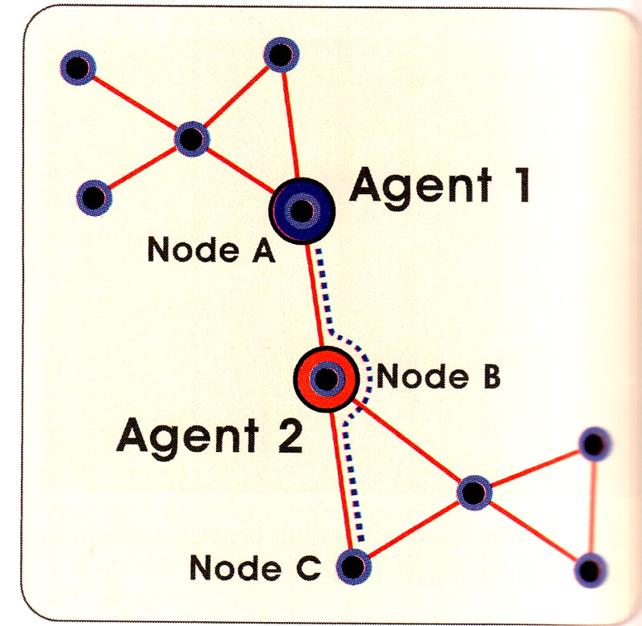
Avoiding Other Agents
Leave space between agents
Path around other agents
Assume no path exists
Request blocking agents to move

Slide 72
Visualization: https://qiao.github.io/PathFinding.js/visual/

Slide 73
Thank you!

